Slide 1
USB Oscilloscope Analog Front-End PCB
Situation
2nd year Design, Construction & Test course final project.
Team of 5 working together remotely during lockdown due to Covid-19 pandemic.
We were each shipped a kit with an STM32 Nucleo board, Opamps, passive components, jumper pins, cables.
We decided on different roles to work in isolation on, liaising every week for updates. The roles were:
Analog front-end design
Write embedded code for Nucleo board
Design GUI in C#
Devise marketing and financial strategies

Slide 2
USB Oscilloscope Analog Front-End PCB
Task
I volunteered for and was elected to design the analog front-end, as it was the discipline I was most passionate about
The Nucleo board and the provided components imposed limitations:
Nucleo board’s PWR pin was only 3.3V
Nucleo board couldn’t generate negative voltages
Components had to be assembled on breadboard
The wires were brittle and easily broken
I have recreated this project in Altium Designer to showcase my proficiency.

Slide 3
USB Oscilloscope Analog Front-End PCB
Action 1
I produced a simple specification:
Attenuate input by a factor of 10
Shift input by half of the power range: 1.65V
Theoretical input range of -16.5V < x < 16.5V
Include protection against outside this range
Keep design as simple as possible

Slide 4
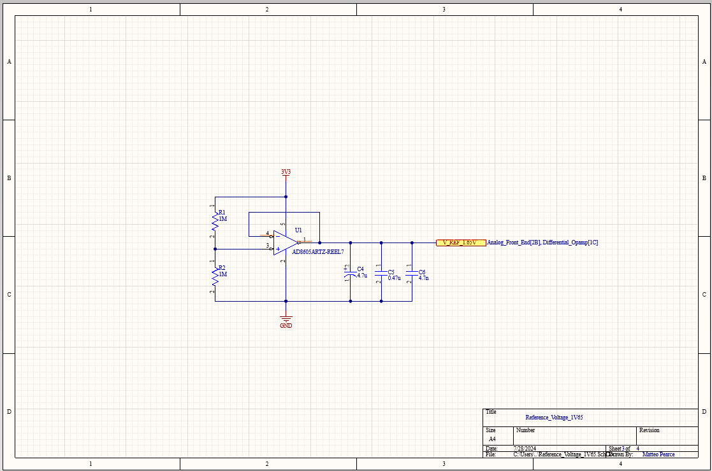
USB Oscilloscope Analog Front-End PCB
Action 2
I used a simple voltage divider and buffer Opamp configuration to generate the 1.65V reference voltage.

Slide 5
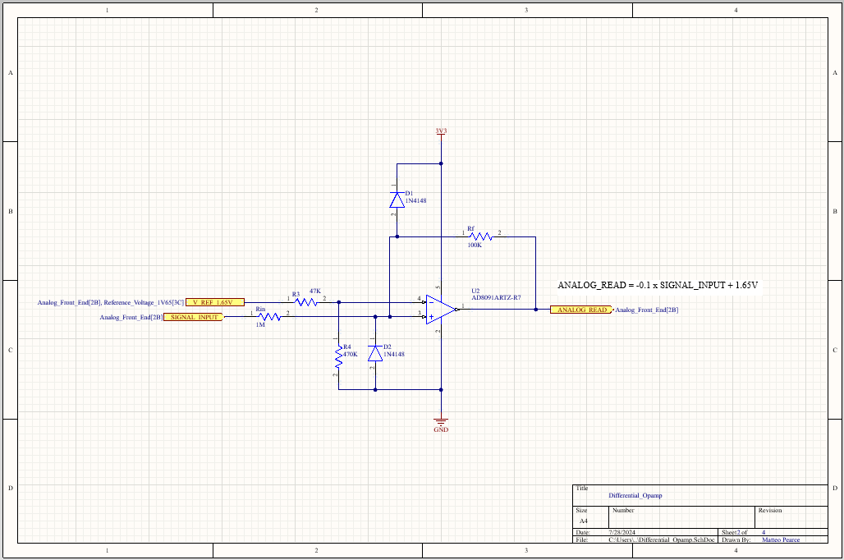
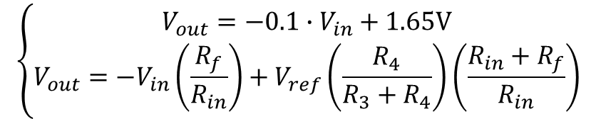
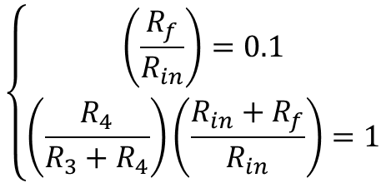
USB Oscilloscope Analog Front-End PCB
Action 3
To attenuate the input signal strength and shift it 1.65V I used a differential Opamp, achieving both objectives in one fell swoop.
I added two diodes between the input line and the power and ground lines to force the voltage to the power supply if the input voltage exceeded 16.5V amplitude.
$$\left\{\begin{aligned}V_{out}=−0.1∙V_{in}+1.65V \\ V_{out}={−V}_{in}\left(\frac{R_{f}}{R_{in}}\right)+V_{ref}\left(\frac{R_{4}}{R_{3}+R_{4}}\right)\left(\frac{R_{in}+R_{f}}{R_{in}}\right)\end{aligned}\right.$$
$$\left\{\begin{aligned}\left(\frac{R_{f}}{R_{in}}\right)=0.1 \\ \left(\frac{R_{4}}{R_{3}+R_{4}}\right)\left(\frac{R_{in}+R_{f}}{R_{in}}\right)=1\end{aligned}\right.$$

Slide 6
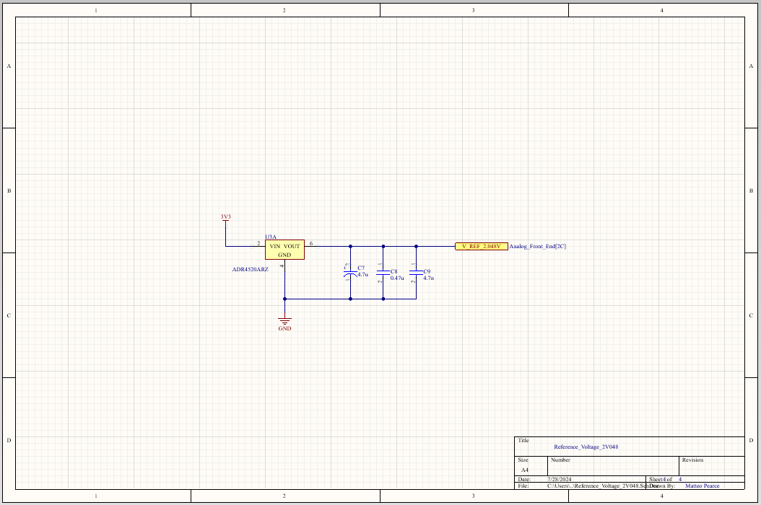
USB Oscilloscope Analog Front-End PCB
Action 4
Due to the small voltage range and sensitivity of the Nucleo Board, I decided to include a voltage reference which could be used for active calibration of the other signals.
$$ε=2.048V−V_REF_2V048$$

Slide 7
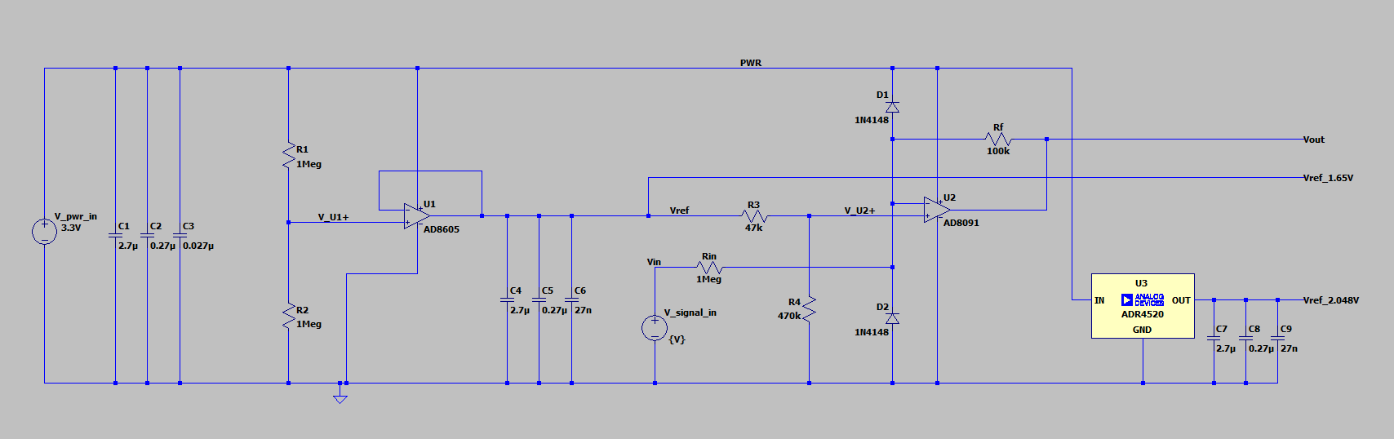
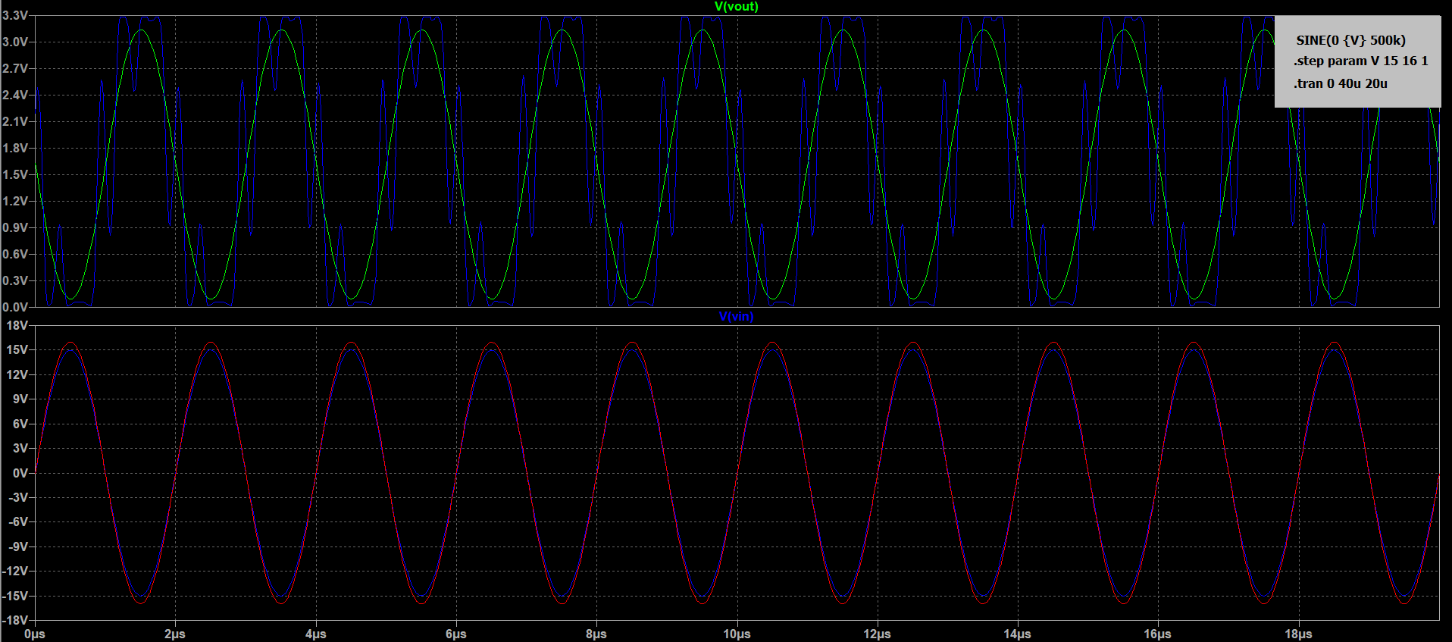
USB Oscilloscope Analog Front-End PCB
Action 5
Each functional block was simulated in LTspice.

Slide 8
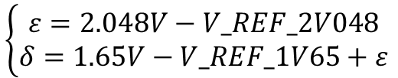
USB Oscilloscope Analog Front-End PCB
Action 6
The board reads the input signal, the 1.65V and the 2.048V reference voltages.
The reference voltages are used to calibrate the input signal:
$$\left\{\begin{aligned}ε=2.048V−V_REF_2V048 \\ δ=1.65V−V_REF_1V65+ε \end{aligned}\right.$$
The input trace is therefore extrapolated from the read signal as:
$$V_{in}=−10\left(V_{out}+ε−\left(1.65V+δ\right)\right)$$

Slide 9
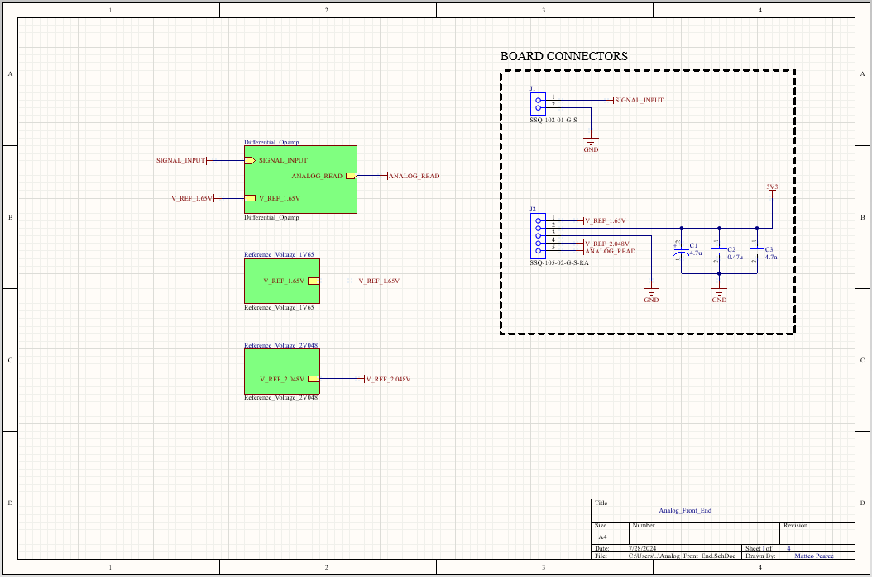
USB Oscilloscope Analog Front-End PCB
The schematics were designed using hierarchical structure and a top-down approach:

Slide 10
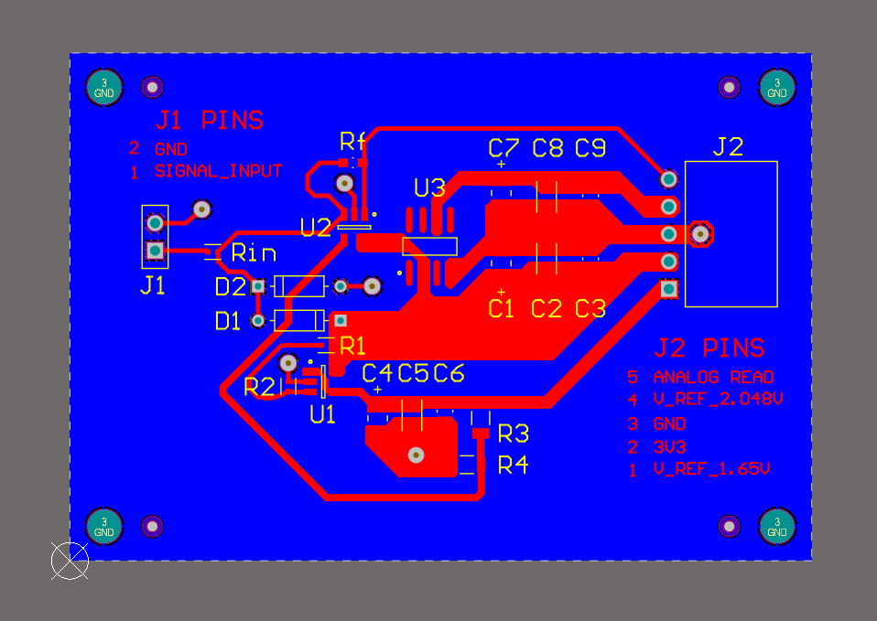
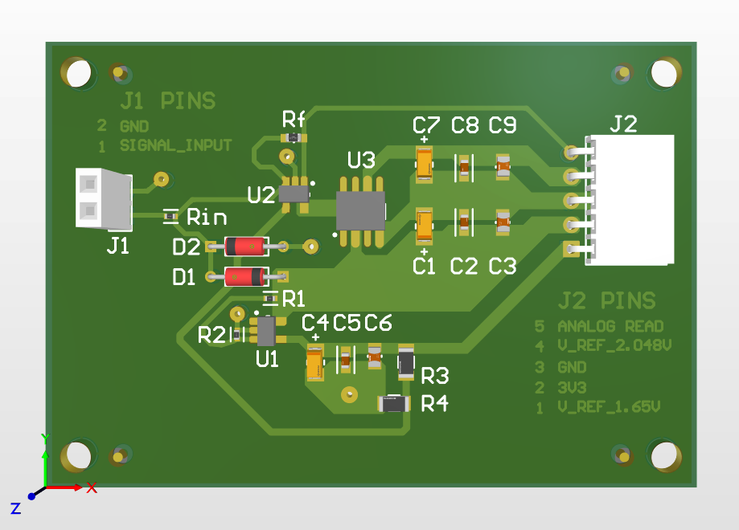
USB Oscilloscope Analog Front-End PCB
Action 7
I also designed the PCB layout and produced manufacturing drawings:

Slide 11
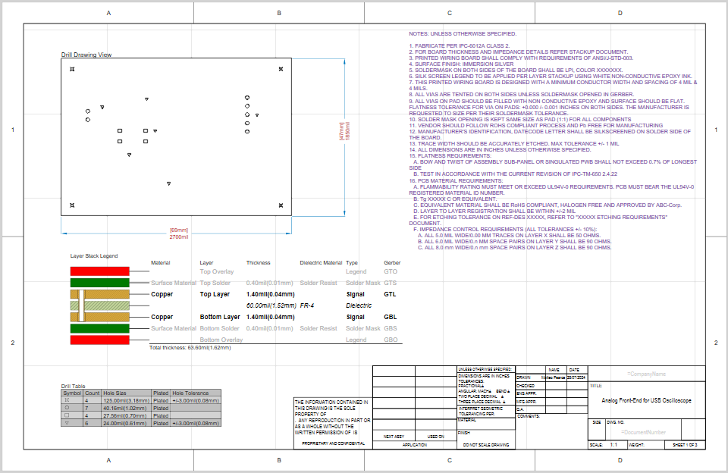

Slide 12
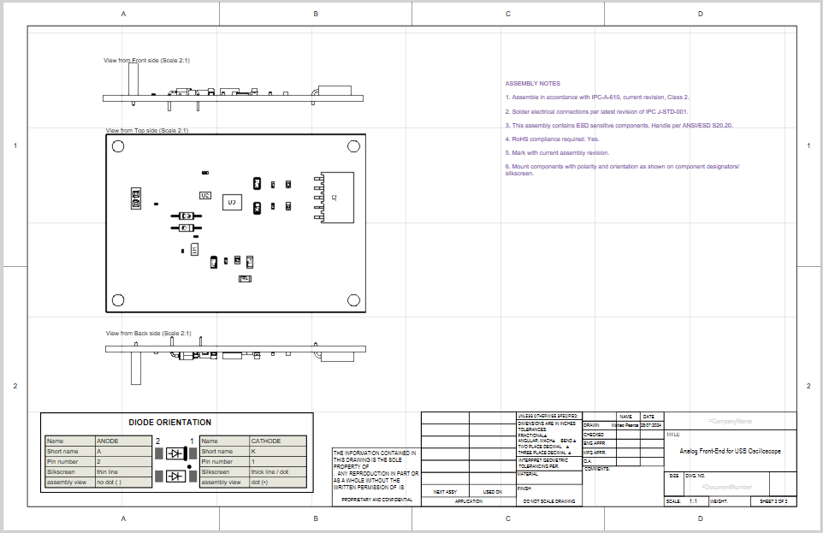
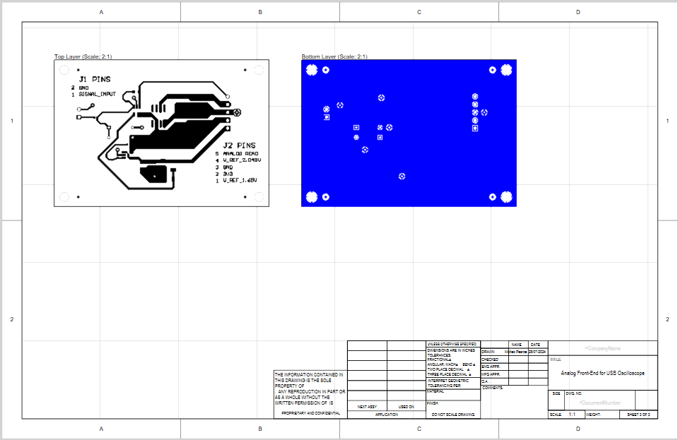

Slide 13
USB Oscilloscope Analog Front-End PCB
Results
Low distortion of sinewave up to ±15.9V at 300kHz.
Low distortion at ±15.9V up to 600kHz.
Low quiescent power consumption between 4.8mW < x < 8.8mW.
Simple BOM and compact PCB footprint.
Achieved an A in the course.
Why I am proud of this project
Achieved success despite the adversity of the circumstances and working in isolation.
Good results that impressed my peers and assessors.
Owned all aspects of the development cycle.

